Slide 1
Tasty Bites Profitability Analysis
Prepared by: Krishan Yadav
Junior Data Analyst
Objective: Improve Profitability & Pricing Strategy

Slide 2
Key Performance Indicators (KPIs)
• Revenue per Product
• Profit Margin per Product
• Units Sold
• Discount Impact on Profit Margin
• Contribution to Total Profit
• Average Order Value (AOV)

Slide 3
Business Objectives
• Identify high-profit and low-profit products.
• Analyze the impact of discounts on profitability.
• Recommend pricing and promotion strategies.
• Increase overall profitability without hurting sales

Slide 4
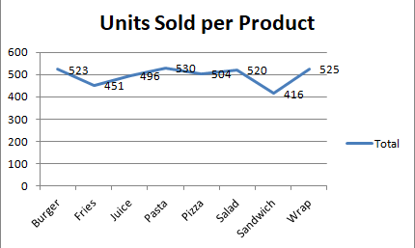
Units Sold per Product
Notes:
• This chart shows how many units were sold for each product.
• Helps identify high-demand and low-demand products.
• Peaks indicate best-selling products, while dips show underperformers.
• Useful for inventory planning and marketing focus decisions

Slide 5
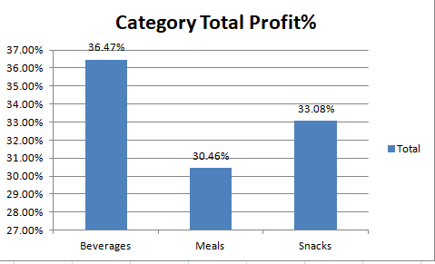
Category-Wise Contribution to Total Profit
Notes:
• This visual represents how much each product category contributes to the total profit.
• Higher contribution indicates better profit margin or stronger demand.
• Use this analysis to prioritize categories in future campaigns.

Slide 6
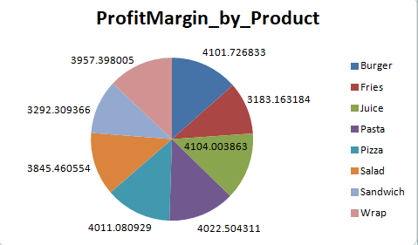
Profit Margin per Product
Notes:
• This chart compares the profit margin across different products.
• Higher margin = better pricing power or lower cost per unit

Slide 7
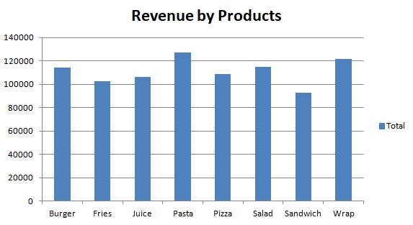
Product-Wise Revenue Performance
Notes:
• This chart shows how much revenue each product generates.
• Helps identify the top-selling products driving the company’s revenue.
• Focus on top 3 products — they contribute the largest share of total revenue.
• Low-performing products may need marketing support or pricing review.

Slide 8
Key Insights from Data
• Top-selling categories include Pasta and wrab.
• High discount rates (>15%) reduce profit margins significantly.
• Juice drive high volume but moderate profit margins.
• NEW customers have higher average order values.
• Beverage category contributes most to total profit.

Slide 9
Recommendations
Quick Wins:
• Reduce discounts on top-selling items.
• Bundle low-performing items with popular ones.
Long-Term Strategies:
• Implement dynamic pricing based on demand.
• Use loyalty programs to retain high-value customers.
• Analyze product costs quarterly to optimize margins.

